Slide 1
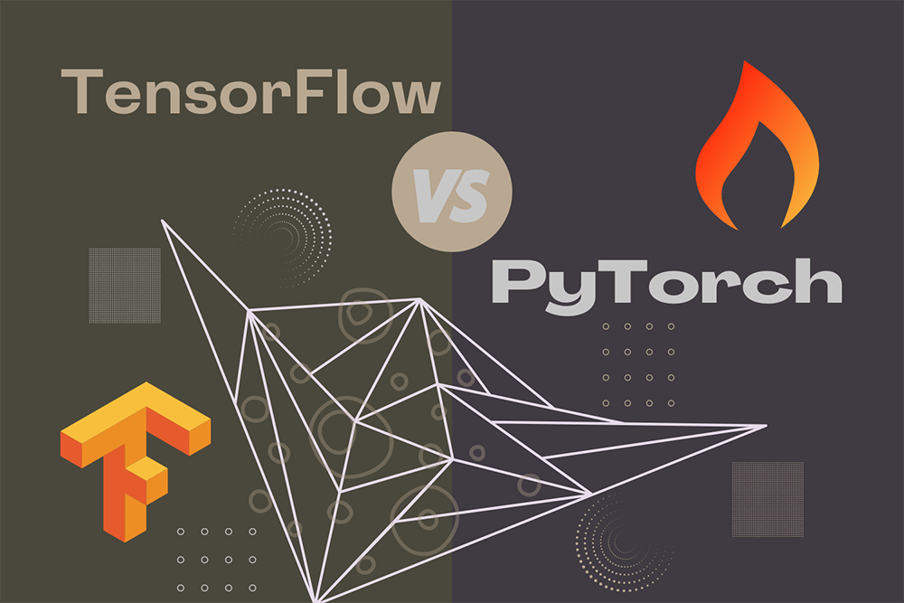
A02a: A Comparative Analysis of Machine Learning and Deep Learning Tools and Frameworks
MM.DD.YY
TensorFlow vs PyTorch: A Comparative Analysis
Group 5:
Marvin Azuogu, Courtney Bernard, Joseph Hiller
Course: ITAI-2376
Instructor: Sitaram Ayyagari
Date: October 4, 2025

Slide 2
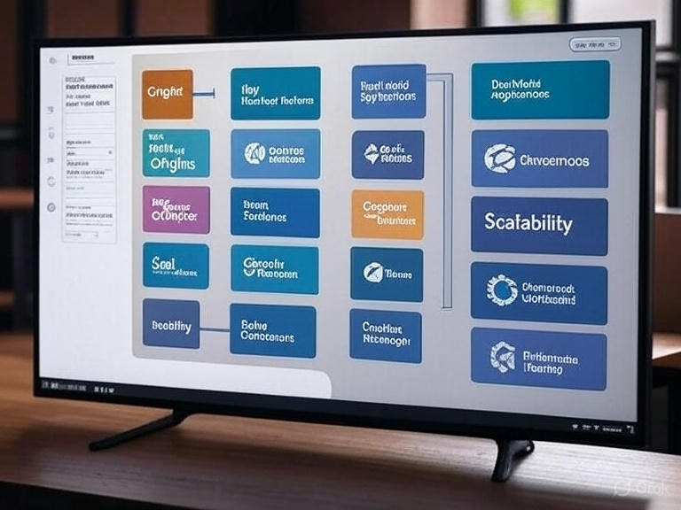
Introduction
This report compares two dominant deep learning frameworks: TensorFlow and PyTorch.
TensorFlow focuses on production deployment and scalability. PyTorch emphasizes research flexibility and ease of use.
Purpose: Evaluate origins, key technical features, real-world applications, usability, performance, support, and scalability.

Slide 3
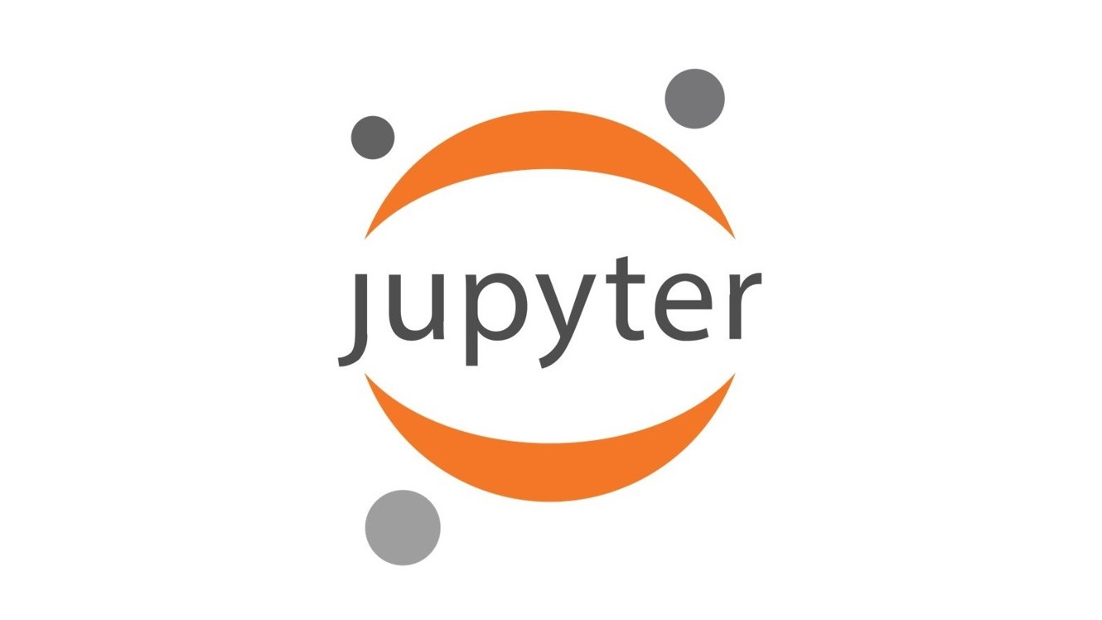

Activities Performed
Systematic review of resources and hands-on experimentation.
Data preparation, model implementation, training, debugging, saving/loading models, benchmarking.
Documented effects of static vs. dynamic graphs and tooling differences.
Notebook Link

Slide 4


Background
TensorFlow: Developed by Google Brain Team in 2015; production-scale deployments, cross-platform compatibility, distributed training, industrial use.
PyTorch: Developed by Meta AI Research in 2016; focuses on rapid research, flexible dynamic graphs, academic use, intuitive Python API.

Slide 5
Key Features
TensorFlow: Deployment tools (Serving, Lite, JS), static graphs with eager execution, TensorBoard, TensorFlow Hub, XLA compiler.
PyTorch: Dynamic define-by-run graphs, Pythonic API, strong debugging, PyTorch Lightning, fastai, Hugging Face integration, TorchScript.

Slide 6
Results & Comparative Table
TensorFlow Strengths: Production tools, mobile/edge support, browser ML, distributed training, visualization tools.
PyTorch Strengths: Intuitive API, dynamic graphs, debugging, strong research community, emerging production tools.

Slide 7
Results & Comparative Table
Aspect | TensorFlow | PyTorch
Usability | Steeper learning curve | Intuitive, easier debugging
Performance | Optimized static graph | Dynamic, competitive speed
Support | Enterprise, Google backing | Research, Meta backing
Scalability | Mature deployment tools | Emerging production solutions

Slide 8
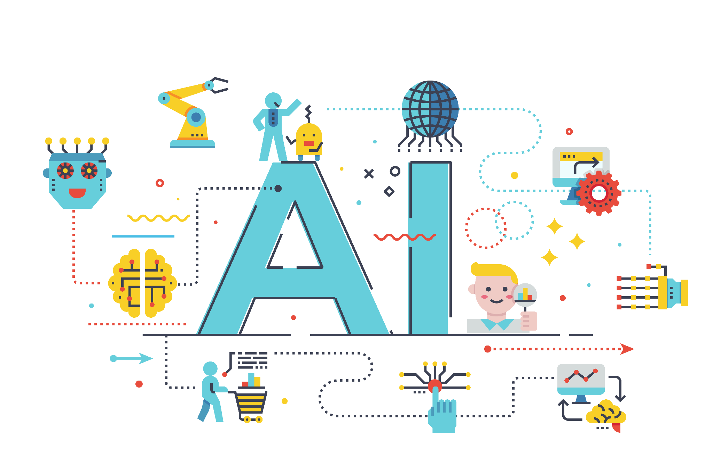
Real-World Applications
TensorFlow: Airbnb (pricing/fraud detection), GE Healthcare (medical imaging), Coca-Cola (quality control), Twitter (recommendations).
PyTorch: Tesla (autopilot), Toyota Research (autonomous vehicles), Microsoft Azure Cognitive Services, OpenAI research models.

Slide 9
Comparative Analysis
Usability: PyTorch offers easier learning and debugging.
Performance: Comparable; task-specific advantages.
Community: TensorFlow strong industry presence; PyTorch leads research papers.
Deployment: TensorFlow more mature; PyTorch rapidly evolving.

Slide 10
Decision Framework
Use TensorFlow for production, mobile, browser integration, enterprise scale, and Google Cloud native.
Use PyTorch for research, rapid prototyping, flexible model design, and academic settings.
Use Both for teams needing versatility and comprehensive ML skillsets.

Slide 11
Conclusion
TensorFlow and PyTorch complement each other: production-first vs. research-first philosophies.
The frameworks are converging; proficiency in both is beneficial.
Final recommendation: TensorFlow for production systems; PyTorch for research and development velocity.

Slide 12
References/Thank You/Q&A
TensorFlow Official Documentation - tensorflow.org
PyTorch Official Documentation - pytorch.org
Papers with Code - Framework Usage Statistics (2024)
Google AI Blog - TensorFlow Development Updates
Meta AI Research Blog - PyTorch Releases and Features
Case Studies from Official Framework Websites
Industry Benchmarking Reports - MLPerf Results
Academic Papers Comparing Framework Performance
Developer Survey Data - Stack Overflow, GitHub
Framework Release Notes and Changelogs

